Slide 1

Uber Data Analysis
Muskan Rao 20104096
Sanskruti Rawal 20104020
Divyal Chheda 21204005
Project Guide
Prof. Geetanjali Kalme

Slide 2
Contents
Introduction
Objectives
Scope
Literature Survey
Proposed System
Project Outcomes
Block Diagram
Use Case/DFD
Technology Stack
Suggestions in Review-1
Result and Discussion
Conclusion and Future Scope
References

Slide 3
1. Introduction
Problem Identified :
Pricing optimization: Uber's pricing strategy is crucial to its success. Data analysis can help Uber identify pricing patterns and trends to optimize fares and increase revenue.
Rider satisfaction: Uber's success is also heavily dependent on rider satisfaction. Data analysis can help identify areas where riders are dissatisfied and suggest improvements to enhance the overall customer experience.
Driver performance: Uber needs to ensure that its drivers are providing a high level of service to riders. Data analysis can help identify areas where drivers are underperforming and suggest training or other measures to improve driver performance.

Slide 4
1. Introduction
Solution Proposed :
The solutions proposed by Uber data analysis can vary depending on the specific insights gained from the analysis.
Here are a few examples of how Uber data analysis can inform solutions :
  Optimal Pricing Strategy
  Efficient Routing
  Driver Allocation
  Surge pricing
  Driver Incentives

Slide 5
2. Objectives
The objectives of Uber data analysis are to gain insights and make data driven decisions that improve the overall performance of the Uber platform. Here are some specific objectives of Uber data analysis:
To improve rider experience by analyzing rider behavior, feedback, and other data.
To Increase driver earnings by analyzing driver earnings data.
To use statistics and visualisations to identify trends in datasets.
To Optimize pricing by analyzing demand patterns and other data.

Slide 6
3. Scope
The scope of Uber exploratory data analysis (EDA) is to investigate and understand the data generated by Uber rides.
This involves analyzing data on source, destination, trip details, and other variables that impact the overall performance of the Uber platform.
The goal of EDA is to uncover patterns and insights in the data that can inform future decisions and strategies.
Data quality and completeness: EDA can involve an examination of the quality and completeness of the data. This includes identifying missing data, outliers, and errors that can impact the analysis.

Slide 7
4. Literature Survey
Sr No. | Title | Author(s) | Year | Outcomes | Methodology | Result
1 | UBER DATA ANALYSIS USING GGPLOT | Mrunal Patil, Vidya Kumari, Adarsh Patil, Laxmikant Ahire and Asst.Prof. Umakant Mandawkar from B.Tech, Computer Science and Engineering, Sandip University, Nashik, India | 2021 | Uber analyze historical data for say, last 3 or 4 weeks and identifies pockets within the city that witness extremely high demand | Estimated Time of Arrival can be reduced with increase in the number of Uber drivers which successively will make Uber more liked by the customers and hence, the company will get more revenue and drivers will also be profited. | At the end of all procedure we get to see different graphs giving us insights.

Slide 8
4. Literature Survey
Sr No. | Title | Author(s) | Year | Outcomes | Methodology | Result
2 | Uber Related Data Analysis using Machine Learning | Rishi Srinivas, B. Ankayarkanni, R. Sathya Bama Krishna | 2021 | The paper explains the working of an Uber dataset, which contains data produced by Uber for New York City. Uber is defined as a P2P platform. | Using the information, the paper explains the use of the k-means clustering algorithm on the set of data and classify the various parts of New York City. Since the industry is booming and expected to grow shortly. | Effective taxi dispatching will facilitate each driver and passenger to reduce the wait time to seek out one another. The model is employed to predict the demand on points of the city.

Slide 9
5. Proposed System
We use the NYC dataset containing data on over 4.5 million trips in NYC from Apr. to Sept. 2014. The files are separated by month and the following columns:
Date
Time Stamp
Destination
Source
Price
There are some of the questions this dataset can be used to answer, we’ll choose the following:
• Uber trips and distribution
• Time when Uber trips occur regularly
• Price range of all rides

Slide 10
7. Outcome of Project
We have seen how the demand follows unique patterns during the day and at some stage in the week.
We have also seen how time affected client trips.
Uber exploratory data analysis (EDA) shows us insights and knowledge that can inform business decisions and strategies.
We have seen how to find accuracy using multiple algorithms and relations between different data attributes.

Slide 11
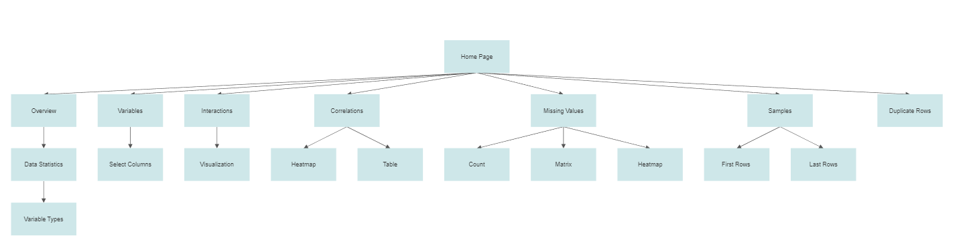
8. Block Diagram

Slide 12
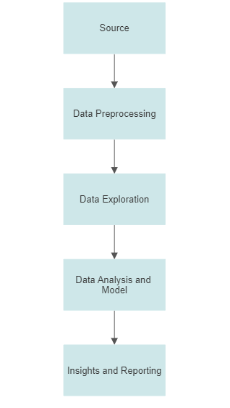
9. DFD Diagram

Slide 13
10. Technology Stack
Python 3
Google colab, VS Code
Streamlit
Packages Used – numpy, pandas, sklearn, scipy, matplotlib, seaborn etc.

Slide 14
Suggestions in Review - 1
Change in Objectives in PPT & Report
GUI for the project
Use case/DFD Diagram

Slide 15
Result and Discussion
The result of Uber data analysis can provide valuable insights into the operations of the taxi service and inform solutions to improve efficiency and customer satisfaction. Here are some possible results and discussions that may arise from Uber data analysis:
Demand Patterns
Route Optimization
Surge pricing
Driver Incentives
Customer Behavior

Slide 16
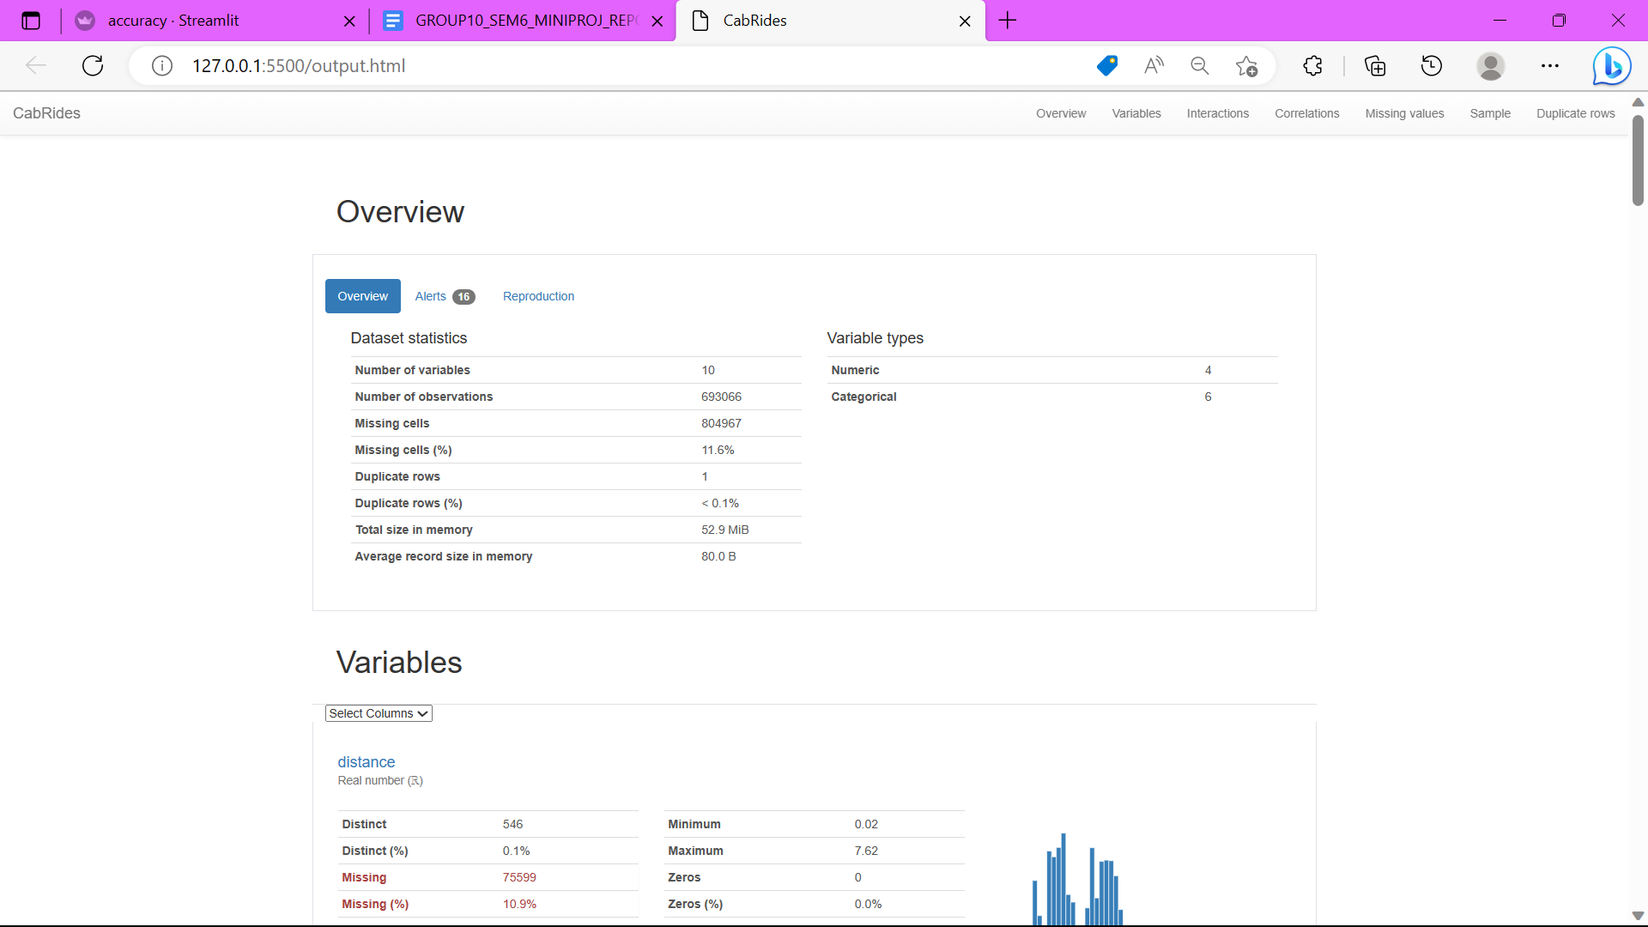
Result and Discussion

Slide 17
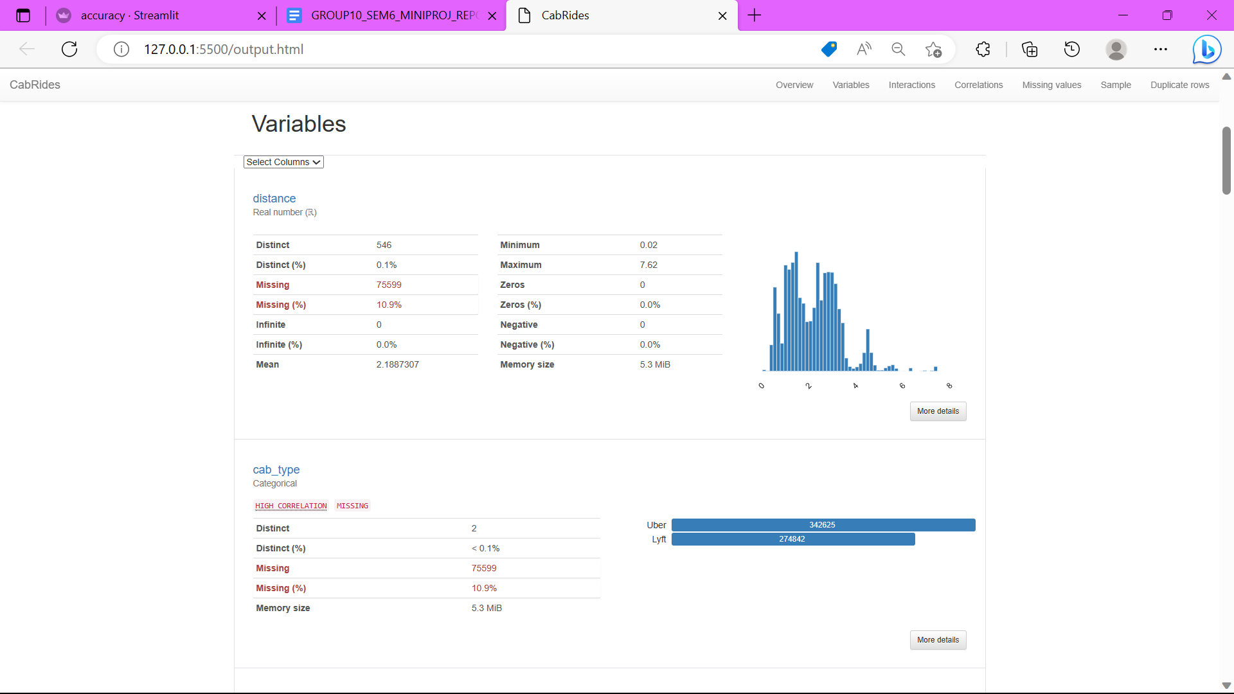
Result and Discussion

Slide 18
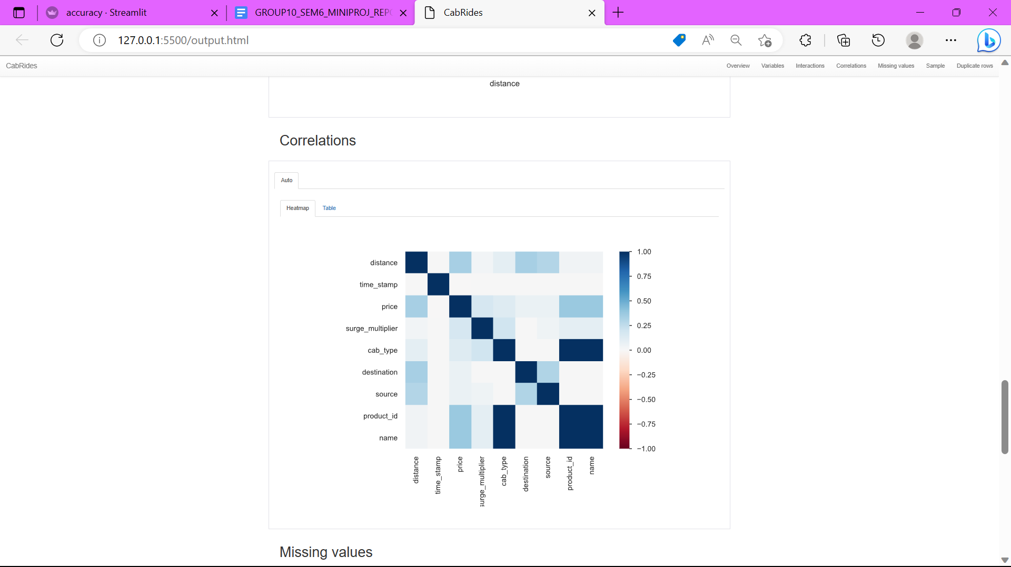
Result and Discussion

Slide 19
Conclusion and Future Scope
Uber data analysis is a powerful tool that can inform solutions to improve the efficiency and customer experience of the taxi service. By analyzing data on demand patterns, route optimization, surge pricing, driver incentives, and customer behavior, Uber can optimize its operations and provide a better experience for both passengers and drivers.
The Future Scope of Uber Data Analysis :
      Artificial Intelligence
      Personalization
      Safety & Security
      Environmental sustainability
      Integration with other services

Slide 20
References
https://jespublication.com/upload/2021-V12I759.pdf
https://ieeexplore.ieee.org/document/94323
https://www.analyticsvidhya.com/blog/2021/10/end-to-end-predictive-analysis-on-ubers-data/
https://github.com/Unnati0104/Uber-Data-Analysis.git

Slide 21
Thank You...!!

